Slide 1
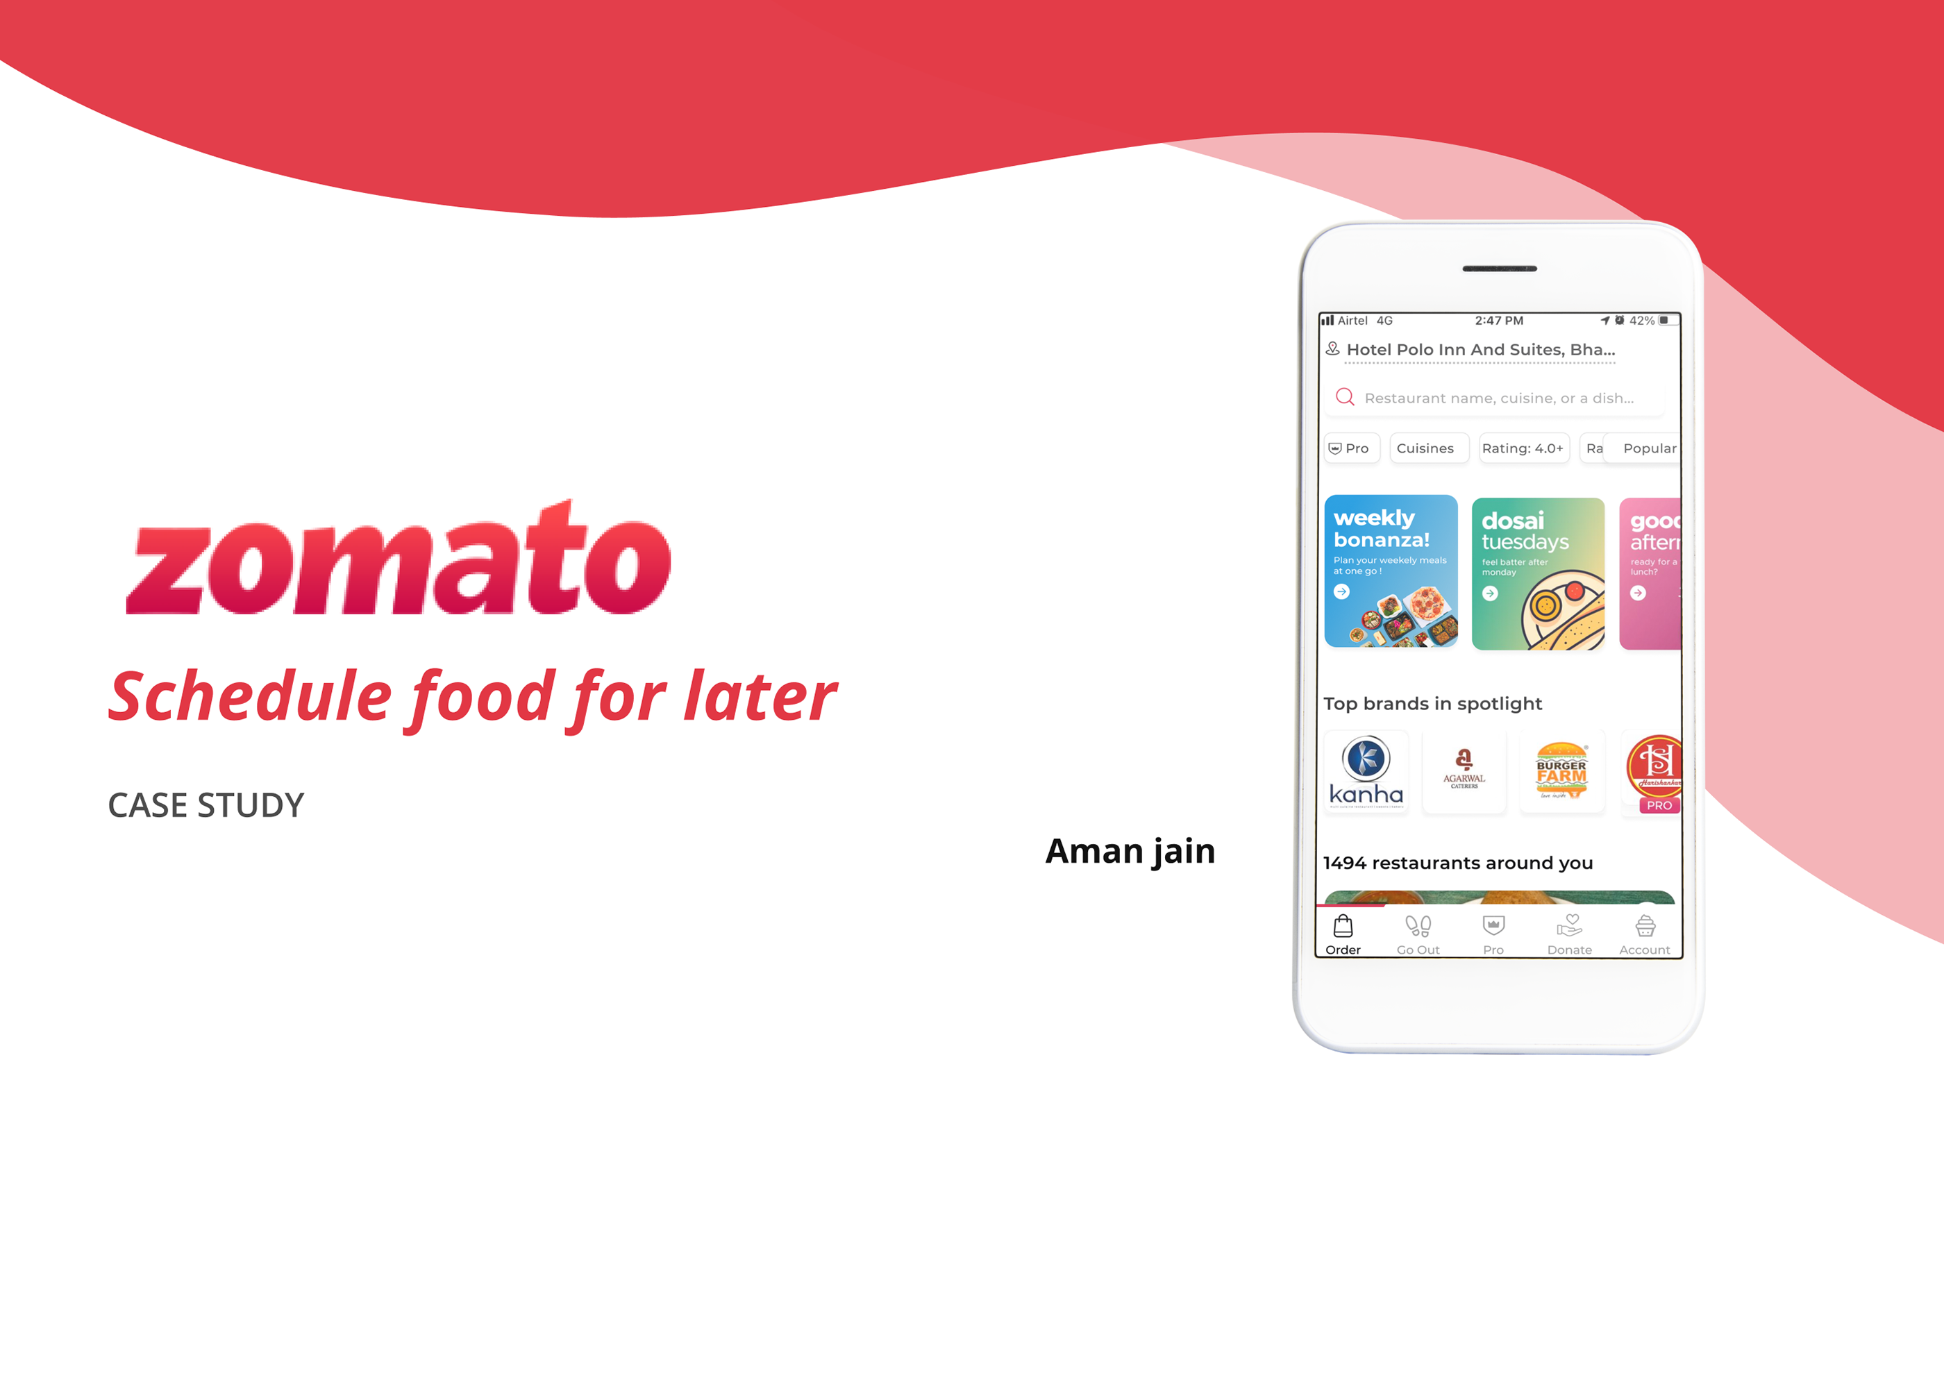
Restaurant Analytics Project

Slide 2
Agenda:
Introduction
Data Cleaning and Preprocessing
Overview & Analysis
Dashboard
Conclusion

Slide 3
Introduction
Zomato is a popular global platform that helps users discover restaurants based on cuisine, pricing, ratings, reviews, and customer votes. With millions of restaurants listed worldwide, it plays a key role in shaping dining decisions.
This project analyzes the Zomato Restaurants Dataset to uncover meaningful insights into restaurant performance and customer preferences. The dataset includes important metrics such as aggregate ratings, number of votes, and average cost for two.
By exploring these attributes, the study aims to identify trends in restaurant popularity, understand the relationship between cost and ratings, and highlight factors that influence user choices.

Slide 4
DATA CLEANING & PREPROCESSING
Challenges:
Data contained null values, special characters in the field, currency was not distributed as per the countries.
Steps Taken:
Removed null values
Standardized currency & location data Categorized price ranges
Removed Special Characters in the field

Slide 5
OVERVIEW :
Dataset Overview:-
Number of restaurants: 9551
Number of Countries : 15
Number of Cites : 141
Number of Cuisines : 1826
Average Ratng of all the restaurant : 2.89

Slide 6
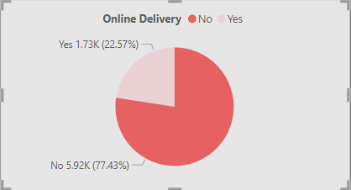
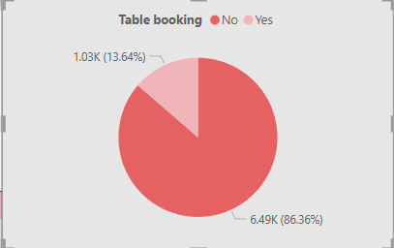
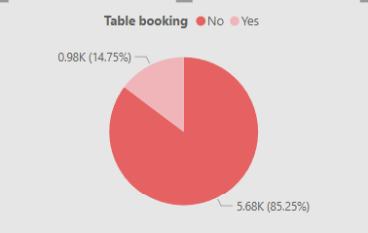
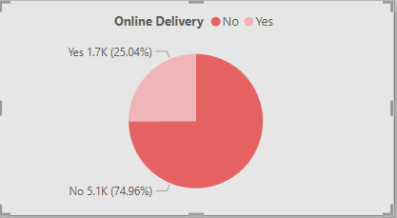
OBSERVATIONS
Out of 9551 restaurants
1.73K(22.57%) restaurants provides Online Delivery whereas 5.92k(77.43%) don’t have the online delivery system
Out of 9551 restaurants
1.03K(13.64%) restaurants provides table booking whereas 6.49k(86.36%) don’t have the table booking facility
For India:
Out of 8652 restaurants
1.7K(25.04%) restaurants provides Online Delivery whereas 5.1k(74.96%) don’t have the online delivery system
Out of 8652 restaurants
0.98K(14.75%) restaurants provides table booking whereas 5.68k(85.25%) don’t have the table booking facility

Slide 7
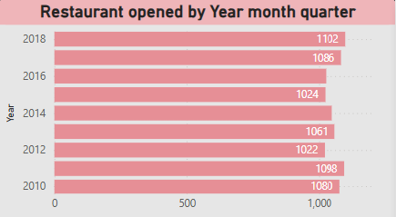
•
Countries which don’t provide online delivery and table booking facility are : Indonesia, Canada, New Zealand, Brazil, Singapore, Sri Lanka Turkey, United States.
In the year 2018 most restaurants were opened (i.e 1102)whereas least restaurants opened in the year 2012(1022)
New Delhi has the most restaurant 5473
•
•

Slide 8
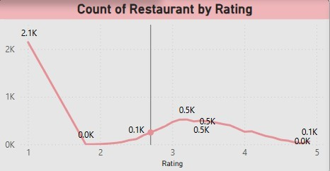
Highest count at Rating 1 (2.1K restaurants)
A significant number of restaurants received the lowest rating.
This could indicate dissatisfaction, poor service, or bad food quality for a large segment.
Sharp drop to nearly 0 at Rating 2
There is almost no representation at a rating of 2.
This suggests that restaurants either receive very low or moderate-to-good ratings, skipping the middle ground.
Gradual rise in Ratings 3 to 4 (around 0.5K each)
Ratings 3 and 4 have a similar number of restaurants (~500 each).
This indicates that a moderate number of restaurants are rated average to slightly above average.
Slight decline toward Rating 5
Only about 0.1K (100 restaurants) received a perfect 5-star rating.
This suggests that very few restaurants achieve the highest rating, possibly due to high customer expectations.

Slide 9
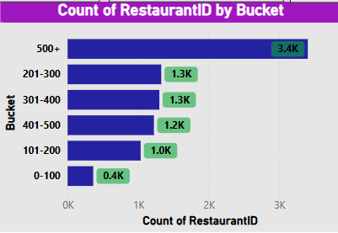
Average cost for two
Restaurants with Average cost for 2 between 0-100 bucket are 0.4k
Highest i.e 500+ average cost there are 3.4k restaurants.
Most restaurants fall into the 500+ category, suggesting market concentration at the higher end.The middle categories (201-500) have a balanced distribution
This analysis suggests that a significant portion of restaurants have a high volume of Price, possibly due to chain restaurants or high operational scale
•
•

Slide 10
Competitor & Market Analysis for the Low rating Restaurants
Competitor Benchmarking: Compare restaurant performance (ratings, reviews, orders) against competitors.
Customer Segmentation: Identify high-value customers and repeat buyers to improve loyalty programs.
Regional Expansion Opportunities: Identify cities/countries with high potential but low restaurant penetration.
Customer Behavior & Satisfaction
Customer Feedback Analysis: Identify common complaints or positive reviews to improve service.
Loyalty & Retention Metrics: Track repeat customers and analyze their average spending patterns.
Order Trends by Time of Day: Identify best-selling dishes and peak ordering times

Slide 11
Restaurant Performance & Profitability
Identify Underperforming Restaurants: Compare ratings, reviews, and sales data to detect struggling locations.
Cost & Profit Analysis: Track expenses, food costs, and delivery charges to optimize pricing strategies.
Most Profitable Cuisines & Dishes: Identify high-margin cuisines and promote them accordingly.
Business Growth Strategy
Franchise & Expansion Strategy: Identify high-potential cities/countries for launching new branches.
Strategic Marketing Plan: Use historical trends to optimize advertising budgets and promotions.
Delivery & Logistics Optimization: Improve delivery efficiency by analyzing delivery times and costs.

Slide 12
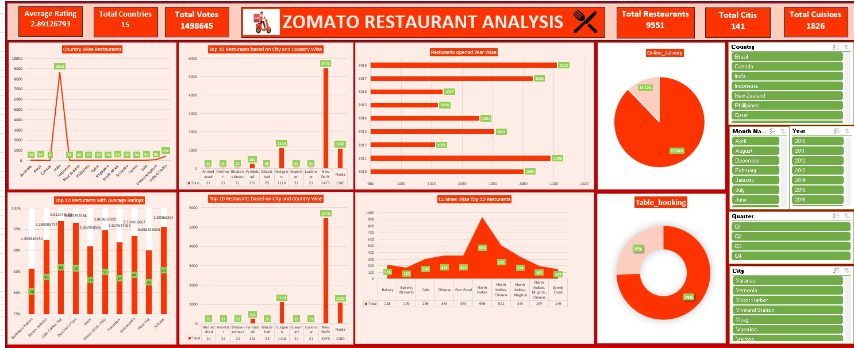
Excel Dashbaord

Slide 13
Conclusion
India has the highest number of restaurants listed in the dataset, highlighting its strong presence on the Zomato platform.
Most restaurants do not provide online delivery or table booking, indicating untapped opportunities for service expansion.
North Indian cuisine emerges as the most popular choice among customers.
Restaurant openings show a steady trend over the years, with noticeable peaks in 2011 and 2018.
The overall average rating of 2.89 suggests significant scope for improving customer experience and service quality.

Slide 14
Thank You!

